Slide 1
Communication – Forms and Types

Slide 2
Five FORMS of Communication
Intrapersonal Communication
Dyadic Communication
Small Group Communication
Public Communication
Mass Communication

Slide 3
Intrapersonal
Happens within oneself
Single sender and receiver
Feelings-pain, emotions – happiness, sadness
Laughter???

Slide 4
Dyadic/ interpersonal
Two persons are involved
Lives influence each other
Planned/ unplanned
Structured and influenced by social expectations
feedback

Slide 5

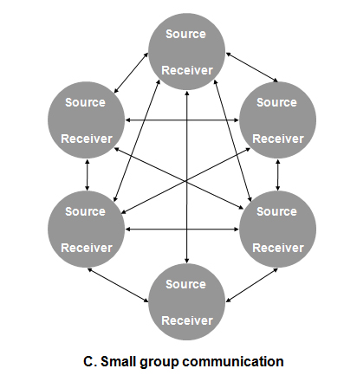
Small group communication
Multiple senders and receivers
Multiple feedback
More intentional and formal than interpersonal communication
Task focussed

Slide 6
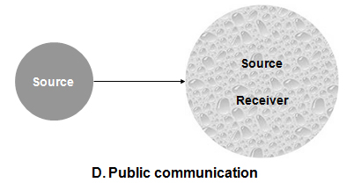
Public Communication
Focus is on the speaker
No feedback
Makes people nervous

Slide 7
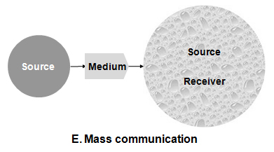
Mass Communication
Large audience
No direct access to receiver
Via a medium
Illusion of personal connection
No direct feedback
Power of 1 to affect many
Questions of ethics in mass communication

Slide 8
Types of Communication
Verbal communication
Non-verbal communication

Slide 9
Verbal & non-verbal communication
Verbal communication refers to our use of words
Nonverbal communication refers to communication that occurs through means other than words, such as body language, gestures, and silence

Slide 10
Verbal communication
Types: Oral (spoken) and Non-oral (written) Communication
Speaking and listening are involved in oral communication
Examples: Face to face conversations, speeches, Interviews, phone calls, verbal communication in broadcasting and media
Forms of verbal communication: Intrapersonal, Interpersonal, Group communication, Public communication

Slide 11
Face to face conversations
Interaction between two or more people while visible to one another
Exchange of more than just words
Significance of body language, gestures, nonverbal expressions
Nonverbal cues enhance better communication
Can be both formal and informal

Slide 12
Continued
Depends on the mutual relationship between the sender and receiver of the message
Being present at the moment
Trust building
One can get instant feedback
Word of mouth effect
Negative aspect: spreading rumours

Slide 13
PHONE CALLS
Use of technology for communication
Both verbal and non-verbal communication
Body language has an impact on the words and tone of speech
Professional tone required to build relationships with colleagues, clients and customers

Slide 14
Continued
Best way to get personal response for quick discussion
Proper telephone etiquette (warm introduction)
Clear articulation of each and every word
Deliverance of clear and concise message for professional works
No hassle of travelling and meeting

Slide 15
Speeches
Important arena of Public speaking
Conveying ideas and influencing the audience through speeches by activists, leaders, educators and business professionals etc.
Develops leadership quality of individuals
Three elements in speech making- speaker, subject and person addressed (Aristotle)

Slide 16
Audience analysis
Important for preparing content of speech
Considering the demographic characteristics and psychological traits of audience
Demographic characteristics: Age, gender, race, ethnicity, culture, religion, region, occupation, education, socio-economic level
Psychological Traits: Beliefs, values, attitudes, psychological needs

Slide 17
Continued
Analysis of these factors influence the speaker to his or her approach to any presentation
Consideration of contextual factors
How much time one would get for speech?
When and where will it be held?
A powerful speech has the power to change people’s attitudes and take action on important issues

Slide 18
Interviews
Face to face conversation between the interviewer and interviewee
Crucial component of recruitment process to choose potential employee for the organization
Significance of both verbal and non-verbal communication
Preparing yourself before the interview
Writing the opening speech and practicing it
Appearing for mock interviews

Slide 19
Verbal communication
Greeting the interviewers in the beginning
To the point answers to the questions asked
Explaining everything in a simple yet concise manner
Brevity and clarity of the answers

Slide 20
Continued
Avoiding complex jargons while speaking
Interviewee can ask relevant questions related to the job
Being vocal about the skills
Ending the interview with a Thank You note

Slide 21
Non-verbal communication
Significance of paralingual communication (Body language)
Greeting the interviewers with a pleasant smile in the beginning
Sit in an upright position
Dressing properly for the interview
Direct eye contact with the interviewers

Slide 22
Continued
Keeping the smiling face throughout the interview (Positive energy)
Listening to the questions attentively
Never interrupt the interviewers while they are asking questions
Stay calm and confident
Making unnecessary sounds or movements can irritate the interviewer

Slide 23
media
The means that uses various methods of communication to disseminate and share ideas, thoughts, information and experiences
Two broad categories: Traditional Media and New Media

Slide 24
FUNCTIONS
Providing information and information exchange
Transmission of values
Education or training
Entertainment
Acts like a catalyst in national development

Slide 25
TRADITIONAL MEDIA
Various forms of mass media communication that existed before the Internet
Examples: Print media such as newspapers, magazines, books and poster
Broadcast media like television and radio

Slide 26
New media
New media represents the forms of media that emerged during the internet era (Rajendran & Thesinghraja, 2014)
Digital platforms and modern technology facilitate communication
Examples: Social Media, websites, blogs, podcasts, online video platforms

Slide 27
CONTINUED
Accessible through smartphones and computers with internet activity
Information spreads rapidly
Disadvantage: Issue of credibility

Slide 28
elements of verbal communication
Sender
Message
Channel
Receiver
Feedback
Context
Noise

Slide 29
Non-verbal communication
Individuals convey information about their emotions, needs, intentions, attitudes, and thoughts without the use of verbal language.
Types: Kinesics, Proxemics, Paralanguage, Haptics, Chronemics, Oculesics

Slide 30
Relevance
Complementing Verbal Communication and better understanding of the message
Regulating conversations
Universal non-verbal cues help to overcome linguistic barriers
Increases workplace efficiency
Trust and credibility reinforcement
Helps to communicate with people with hearing disability

Slide 31
THANK YOU

